Slide 1

CS 533 INTRO TO DATA SCIENCE
Michael Ekstrand

Slide 2
FEATURE TRANSFORMS

Slide 3

Learning Outcomes
Transform individual features
Derive features
Combine features
This applies to both regression and classification models
Photo by Clay Banks on Unsplash

Slide 4
Discrete Feature Transforms
Recode
Rename codes (for interpretability)
Merge codes (some distinctions irrelevant)
Convert to logical or 0/1 numeric
‘is value’
>= value (for ordinal) (e.g.: ‘rated positively’ for >3 stars)
Dummy-code

Slide 5
Individual Continuous Feature Transforms
Log
Square root
Square (or higher-order polynomial)
Standardize and center
Discretize (convert to bins)

Slide 6
When to Transform?
Feature has nonlinear relationship to outcome
Transformation can make it linear
Feature is not normally distributed
Not inherently a problem
But close-to-normally-distributed features can work better + be linear

Slide 7
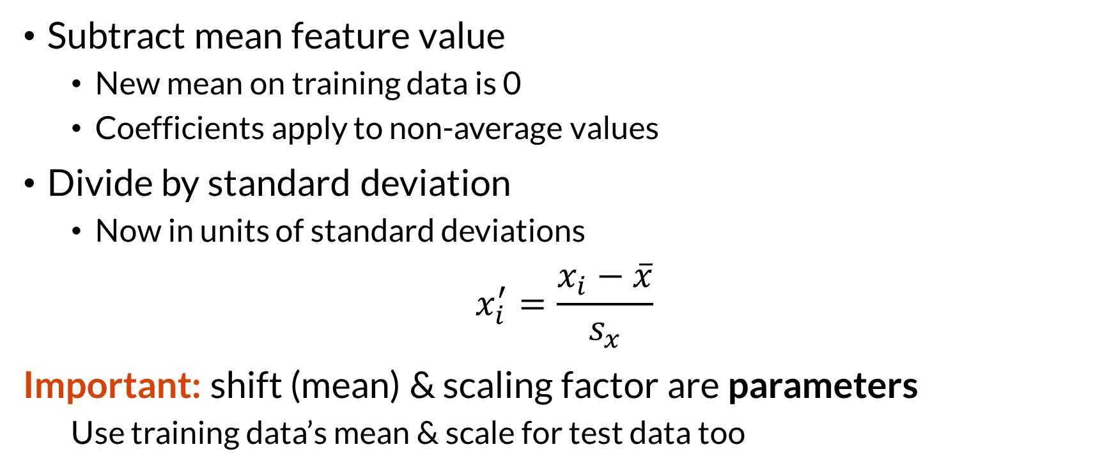
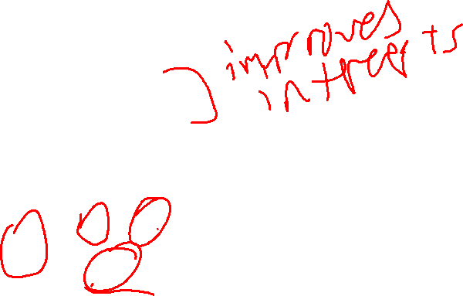
Example: Standardizing
Subtract mean feature value
New mean on training data is 0
Coefficients apply to non-average values
Divide by standard deviation
Now in units of standard deviations
$$x_{i}^{′}=\frac{x_{i}−\overline{x}}{s_{x}}$$
Important: shift (mean) & scaling factor are parameters
Use training data’s mean & scale for test data too

Slide 8
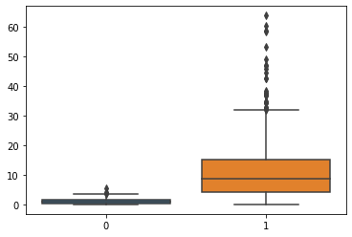
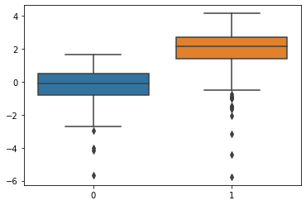
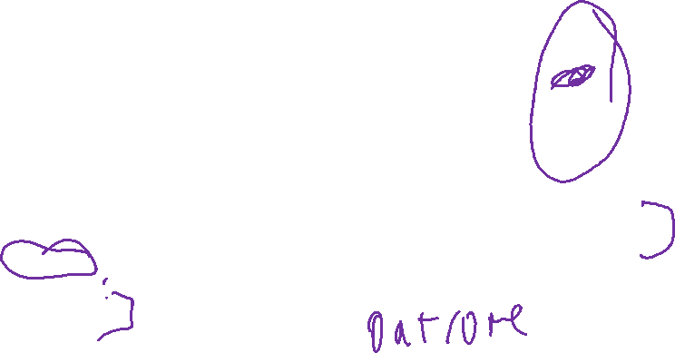
Example: Log Transform
Heavily skewed data
Large values -> large swings (or small coefficients)
Log transform: less skew, smaller range

Slide 9
Example: Discretizing
Sometimes from outside knowledge
Term >= 240 months ⇒ real estate loan (A5)
> 3 stars ⇒ “liked” (can reduce noise in ratings!)
Nonlinear response with sharp change at “is high”
>= median (or mean)
Inflection point
Discretization can have subtle effects — be careful

Slide 10
Advanced Transforms
Box-Cox or Power transformations
Make anything (almost) normal
Spline functions
Learn complex functions of a single variable

Slide 11
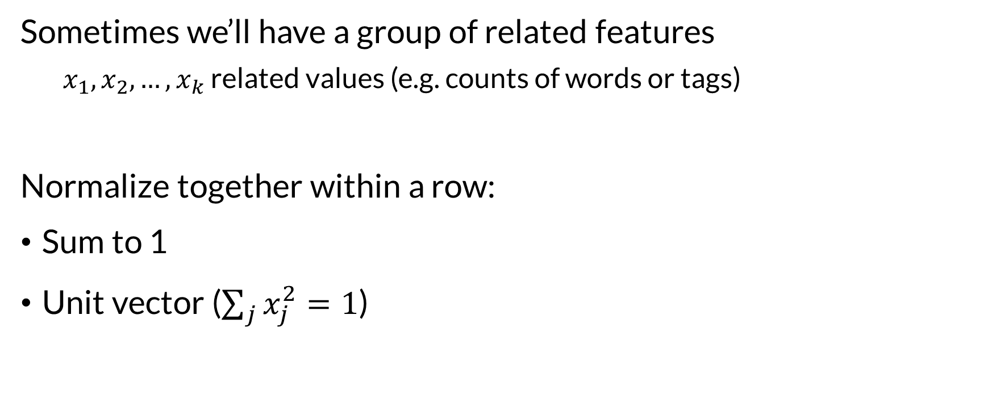
Multi-Feature Normalizations
Sometimes we’ll have a group of related features
$x_{1},x_{2},…,x_{k}$ related values (e.g. counts of words or tags)
Normalize together within a row:
Sum to 1
Unit vector ($\sum_{j}{x_{j}^{2}}=1$)

Slide 12
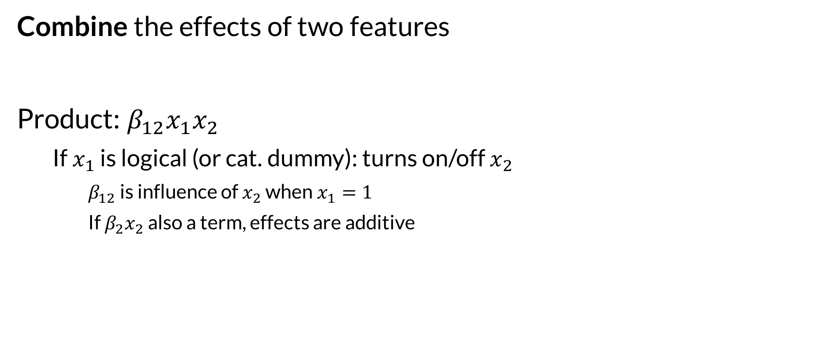
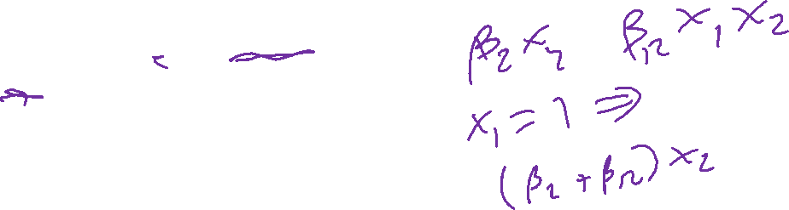
Interaction: Product
Combine the effects of two features
Product: $β_{12}x_{1}x_{2}$
If $x_{1}$ is logical (or cat. dummy): turns on/off $x_{2}$
$β_{12}$ is influence of $x_{2}$ when $x_{1}=1$
If $β_{2}x_{2}$ also a term, effects are additive

Slide 13
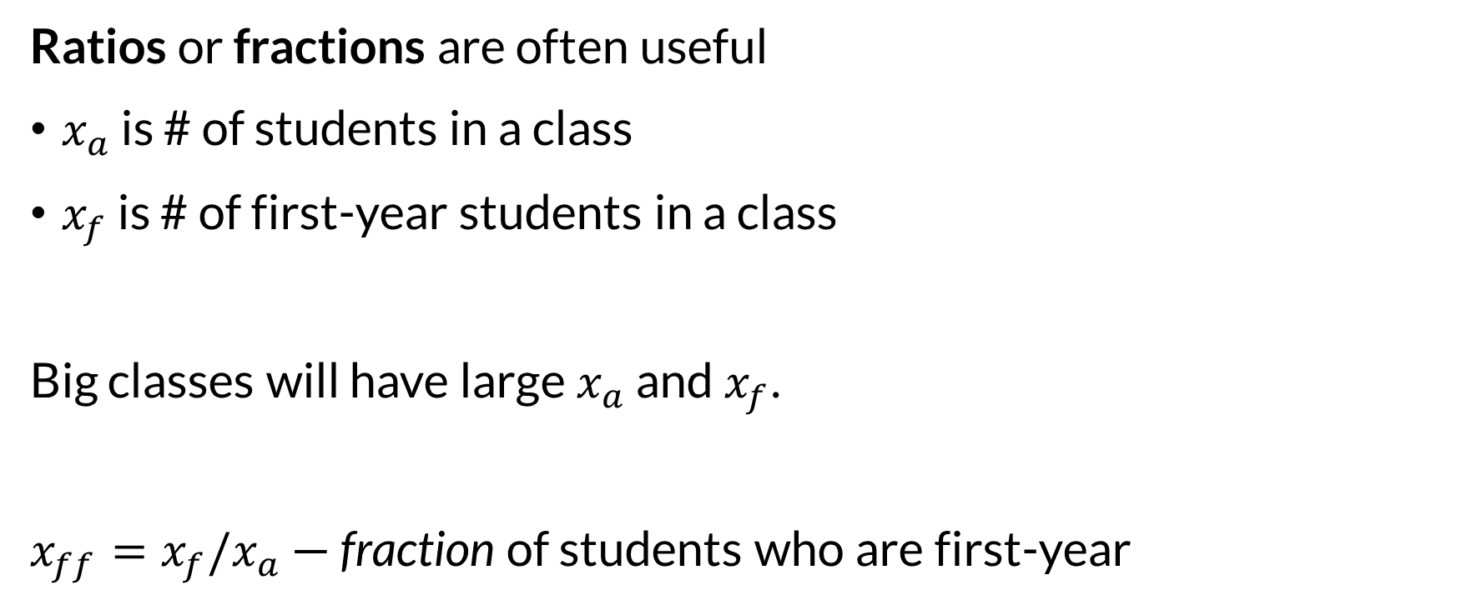
Interaction: Ratio or Fraction
Ratios or fractions are often useful
$x_{a}$ is # of students in a class
$x_{f}$ is # of first-year students in a class
Big classes will have large $x_{a}$ and $x_{f}$.
$x_{ff}=x_{f}/x_{a}$ — fraction of students who are first-year

Slide 14
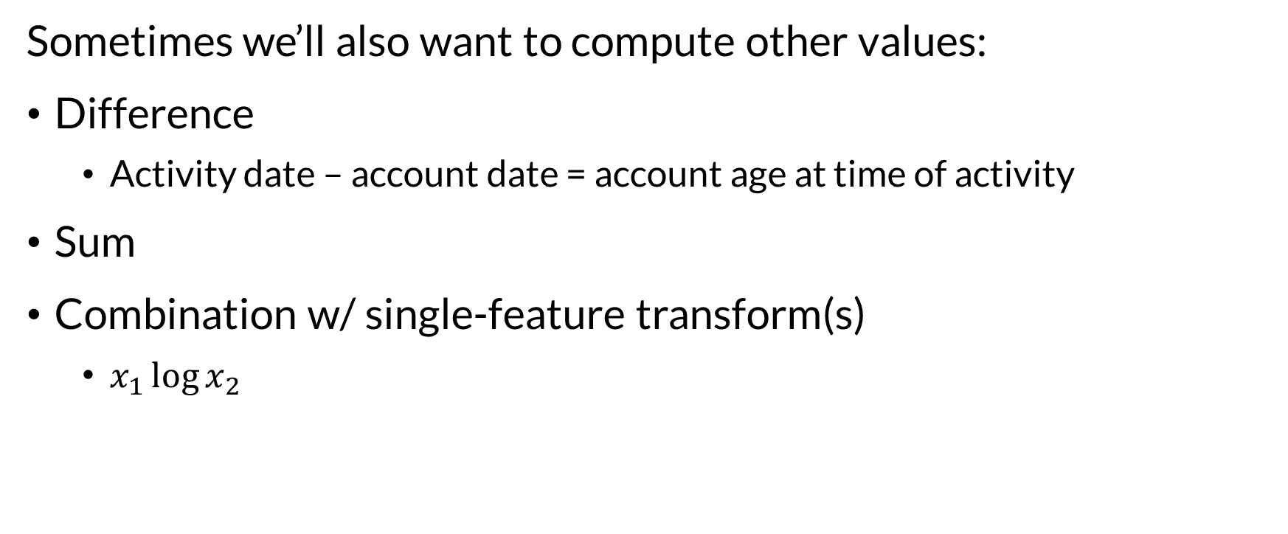
Other Combinations
Sometimes we’ll also want to compute other values:
Difference
Activity date – account date = account age at time of activity
Sum
Combination w/ single-feature transform(s)
$x_{1}\log{x_{2}}$

Slide 15
Developing Features
It takes practice and creativity
Look for normality
Look for linear relationships
Look for hard jumps (discretization useful)
Read people writing about their features
Do feature exploration & design on training data.

Slide 16

Wrapping Up
Transforming and expanding features is a powerful part of model building.
The model can only work with the features you give it.
Photo by Max Bender on Unsplash

